Slide 1

Substitution Method
Nav Sanya Anand

Slide 2
Steps to follow
Assume a solution
Set the goal
Set the hypotheses: The previous step is true
Take steps to prove the goal

Slide 3
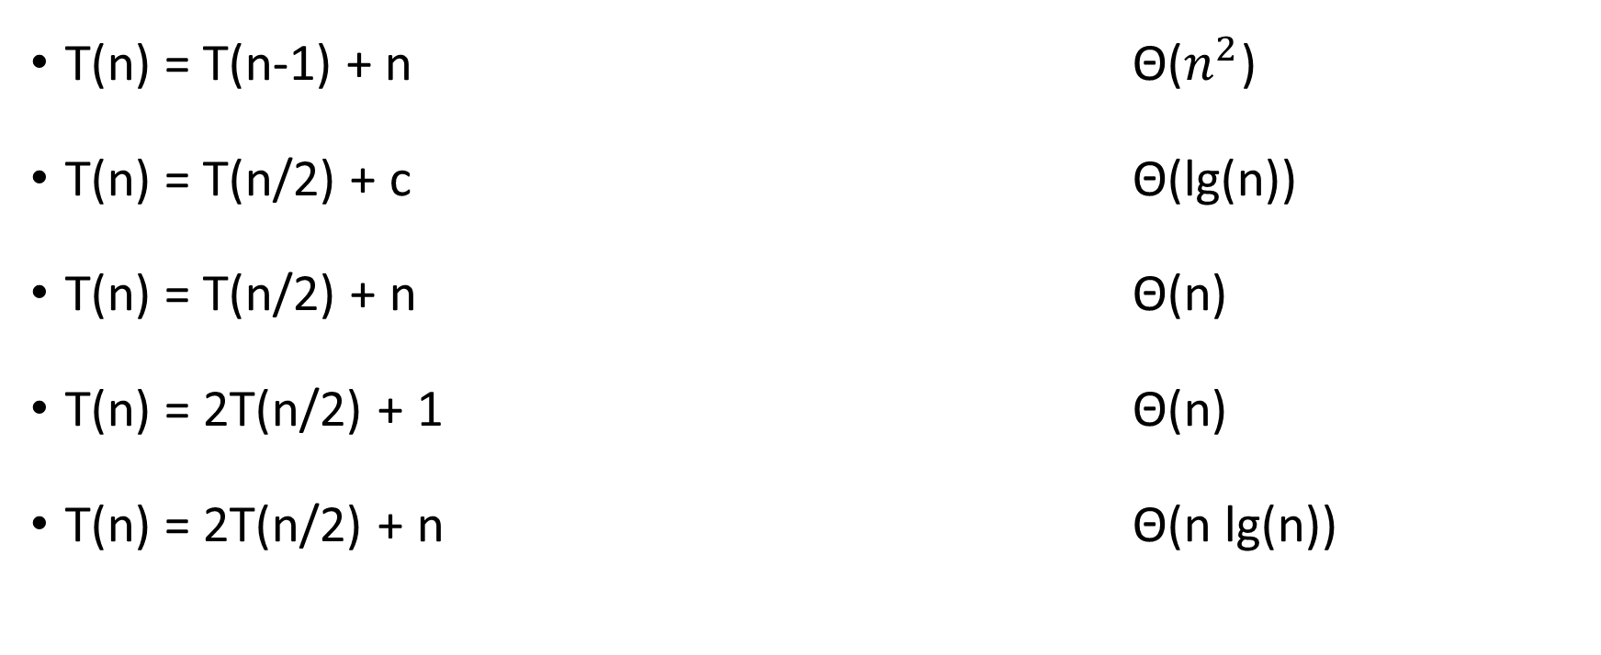
Points to Note
T(n) = T(n-1) + n Θ($n^{2}$)
T(n) = T(n/2) + c Θ(lg(n))
T(n) = T(n/2) + n Θ(n)
T(n) = 2T(n/2) + 1 Θ(n)
T(n) = 2T(n/2) + n Θ(n lg(n))

Slide 4
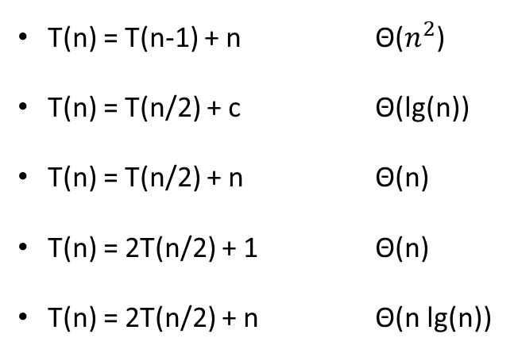
Example 1 - T(n) = c + T(n/2)
Assume: T(n) = Θ(lg(n))
T(n) = T(n-1) + n Θ($n^{2}$)
T(n) = T(n/2) + c Θ(lg(n))
T(n) = T(n/2) + n Θ(n)
T(n) = 2T(n/2) + 1 Θ(n)
T(n) = 2T(n/2) + n Θ(n lg(n))
Goal: T(n) <= x lg(n)
Hypotheses: T(n/2) <= x lg(n/2)
Proof:
T(n) = T(n/2) + c
T(n/2) + c <= x lg(n/2) + c
T(n/2) + c <= x [lg(n) – lg(2)] + c
T(n/2) + c <= x [lg(n) – 1]+ c
log a/b = log a – log b
T(n/2) + c <= x lg(n) – x + c
log_{a}(a) = 1
x lg(n) – x+ c <= x lg(n)
if:
-x+c <= 0
x > c
Proved. Therefore, T(n) = Θ(lg(n))

Slide 5
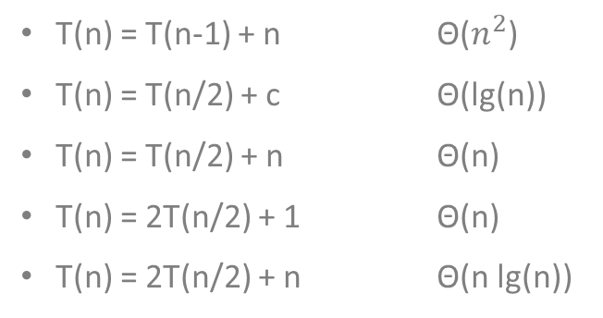
Example - T(n) = n + 2T(n/2)
Assume: T(n) = Θ(n lg(n))
T(n) = T(n-1) + n Θ($n^{2}$)
T(n) = T(n/2) + c Θ(lg(n))
T(n) = T(n/2) + n Θ(n)
T(n) = 2T(n/2) + 1 Θ(n)
T(n) = 2T(n/2) + n Θ(n lg(n))
Goal: T(n) <= x n lg(n)
Hypotheses: T(n/2) <= x 2n/2 lg(n/2) <= x n lg(n)
Proof:
T(n) = 2T(n/2) + n
T(n/2) + c <= x n lg(n/2) + n
T(n/2) + c <= x n [lg(n) – lg(2)] + n
T(n/2) + c <= x n[lg(n) – 1]+ n
log a/b = log a – log b
T(n/2) + c <= x n lg(n) – x n + n
log_{a}(a) = 1
x lg(n) – xn + n <= x ln g(n)
if:
-xn+n <= 0
n(-x+1) <= 0
-x + 1 <=0 x>=1
Proved. Therefore, T(n) = Θ(lg(n))

Slide 6

References

